Slide 1
Data Access Part 1
Module 2

Slide 2
Objectives
Understand the use and benefits of:
CRM WCF Web Services
Accessing Organizations with the Discovery Service
Organization Service
CRUD operations with the Organization Service
Early and late-bound classes
CRM data types
Compare CRUD operation techniques
Notes:
Discuss the use and benefits of the Windows Communication Foundation in Microsoft Dynamics CRM 365.
Use the Discovery Service web service to access Organization-level information.
Explain the differences between early and late-bound classes.
Explain the advantages and process of using early-bound code.
Develop custom code that uses late-bound classes.
Reference and use the Organization Service.
Explain security dependencies.
Identify how Entity information is used within the Organization web service.
Identify the different Microsoft Dynamics CRM data types.
Use the Create, Retrieve, Update and Delete methods of the Organization Service.
Identify how to manage exceptions thrown by the Microsoft Dynamics CRM platform.

Slide 3
Objectives – continued
Comparing different Data Access Techniques
QueryExpression
QueryByAttribute
LINQ
FetchXML
WebAPI
Notes:
Other considerations for the data access technique are online – can not use Filtered Views, oData limited to JavaScript and Silverlight clients within the CRM context. LINQ uses early bound types which are a snapshot of the CRM system at the point the CrmSvcUtil.exe was run to generate the classes. Also consider ease of change, management, steepness of learning curve for new developers

Slide 4
Dynamics 365 Web Services
Discovery Service
Determines the organizations a user is authenticated against
Returns the endpoint for the Organization Service
Organization Service
Allows CRUD interaction with Microsoft Dynamics 365 entities and application processes
Dynamics 365 Web API
Implements OData version 4.0
Notes:
All data operations apart from Filtered Views go through the Web Services Layer, These can be accessed independently or via SDK API calls.
Use the Discovery service to find organisations and addresses of services. Normally the developer will know the organization service address, but it is essential if there are many organisations on-premise to connect to one, and also from the perspective of generic scripts, helping a user to select their organization.
The Organisation service allows CRUD calls to the CRM platform layer, as well as calls to run business processes (assign users, retrieve metadata, create new entities etc. via the Execute method).
The Web API, which is new for Microsoft Dynamics 365 (online & on-premises), provides a development experience that can be used across a wide variety of programming languages, platforms, and devices. The Web API implements the OData (Open Data Protocol), version 4.0, an OASIS standard for building and consuming RESTful APIs over rich data sources
The OData Service allows CRUD access to Dynamics 365 data, and associate and disassociate actions via Jscript.
In addition WebAPI provides access to system operations (WhoAmI, CalculateRollUpField, RetrieveAllEntities (metadata))
To access the addresses of the services, use the Settings – Customisations – Developer Resources link.

Slide 5
Dynamics Web Services – Dynamics SDK Libraries
The SDK provides a set of APIs that encapsulate the access to the Web Services
The SDK libraries provide proxies that eliminate the need to interact with SOAP messages directly
Any .Net application can consume Dynamics 365 web services
Can access web services directly with XMLHttpRequest and generation of SOAP messages
Warning – highly recommended to use nuget from Visual Studio to include required SDK .dlls.
Notes:
The bin folder of the SDK installation folder includes the necessary DLLs that provide the Web Service proxies, and associated message types (Data Transfer Objects), used in Web Service communication. Consuming applications can either reference these assemblies or by installing the CRM Nuget packages in .Net the appropriate DLLs are added to the consumer assembly. These SDK assemblies provide intellisense and the accompanying SDK.chm help files provide guidance, access to example scripts, as well as sample applications.

Slide 6
Access Discovery Service
The Discovery web service is used to determine the organizations that a user is a member of
And the endpoint address URL to access the Organization web service for each of those
This Discovery service is necessary because Microsoft Dynamics 365 is a multi-tenant environment—a single Microsoft Dynamics 365 server can host multiple business organizations
By using the Discovery web service, your application can determine the endpoint address URL to access the target organization’s business data
Notes:
The discovery service will only return the organisations you are authenticated against, many CRM addins work from perspective that organization address is unknown and ask for Discovery Service address first, eg. Plugin registration. When connecting to Dynamics 365 online Discovery service a combination of user and device credentials are supplied. The SDK ships with a device registration tool that generates a device username/password that can be used to register a device username/password for the client app.
https://community.dynamics.com/crm/b/mscrmshop/archive/2012/08/19/how-to-create-a-meaningful-device-credentials-using-device-registration-tool
https://rajeevpentyala.com/tag/device-registration/

Slide 7
OrganizationService
Web service that accesses data and metadata for your organization
This web service contains the methods that you use to write code that uses all the data and metadata in Microsoft Dynamics 365
To use the IOrganizationService web service, add a reference to the Microsoft.Xrm.Sdk.dll assembly to your Microsoft Visual Studio project
To access the non-core xRM messages, add a reference to the Microsoft.Crm.Sdk.Proxy.dll assembly to your project
Warning – use Nuget - Microsoft.CrmSdk.CoreAssemblies to get core SDK dlls.
Use other nuget packages in Microsoft.CrmSdk and Microsoft.CrmSdk.XrmTooling namespaces as required.
Notes:
In Microsoft Dynamics 365, the primary web service that accesses data and metadata for your organization is IOrganizationService. This web service contains the methods that you use to write code that uses all the data and metadata in Microsoft Dynamics 365.
USE NUGET to access SDK DLLs
To use the IOrganizationService web service, add a reference to the Microsoft.Xrm.Sdk.dll assembly to your Microsoft Visual Studio project. To access the non-core xRM messages, add a reference to the Microsoft.Crm.Sdk.Proxy.dll assembly to your project also. Alternatively, add the service reference to your project. More information: Download the endpoints using the Microsoft Dynamics 365 Developer resources page

Slide 8
Access Discovery Service Online
using (DiscoveryServiceProxy serviceProxy = new DiscoveryServiceProxy(new Uri(discoUrl),
null, userCred, deviceCred))
{
OrganizationServiceProxy orgProxy = getInfo(serviceProxy);
}
Notes:
Only search for the organisation service address when not known as timely or because customisations are being delivered to a multi tenancy environment
The discovery service will only return the organisations you are authenticated against, many Dynamics 365 addins work from perspective that organization address is unknown and ask for Discovery Service address first, for instance the plugin registration tool. When connecting to Dynamics 365 online Discovery service a combination of user and device credentials are supplied. The SDK ships with a device registration tool that generates a device username/password that can be used to register a device username/password for the client app.
https://community.dynamics.com/crm/b/mscrmshop/archive/2012/08/19/how-to-create-a-meaningful-device-credentials-using-device-registration-tool
https://rajeevpentyala.com/tag/device-registration/

Slide 9
OrganizationService
// Retrieve details about all organizations discoverable via the
// Discovery service.
RetrieveOrganizationsRequest orgsRequest =
new RetrieveOrganizationsRequest()
{
AccessType = EndpointAccessType.Default,
Release = OrganizationRelease.Current
};
RetrieveOrganizationsResponse organizations =
(RetrieveOrganizationsResponse)serviceProxy.Execute(orgsRequest);

Slide 10
OrganizationService
foreach (var endpoint in organizations.Details[0].Endpoints)
{
if (endpoint.Key == EndpointType.OrganizationService)
{
var organizationProxy = new OrganizationServiceProxy(new Uri(endpoint.Value), null, userCred, deviceCred)
return organizationProxy;
}
}

Slide 11
Using the Tooling Connector Library
XRM tooling is a set of APIs built on top of the Microsoft Dynamics 365 SDK assembly APIs
Supports all the authentication modes to sign into Dynamics 365
Provides Windows PowerShell support for authentication and connection to Dynamics 365
Supports secure storage of the sign-in credentials and reuse of the stored credentials to automatically sign in to Dynamics 365 after initial sign in
Provides built-in diagnostic tracing and performance reporting
Use nuget packages in Microsoft.CrmSdk and Microsoft.CrmSdk.XrmTooling namespaces as required to access the Tooling Connector library
Notes:
Microsoft.Xrm.Tooling.Connector library has been made available by the Dynamics 365 SDK team to make it easy to perform common operations, using direct functions that have been exposed for these.

Slide 12
Creating the OrganizationService Proxy
Set a reference to the tooling connector library (sdk)
Use Nuget to refer to Microsoft.CrmSdk.XrmTooling.CoreAssembly package
Create a valid connection string (stored in app.config file)
Notes:
Make sure to use Nuget to refer to SDK dll’s.

Slide 13
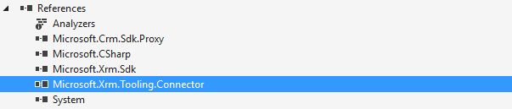
Creating the OrganizationService Proxy
<connectionStrings>
<add name="CrmOnline" connectionString="Url=https://qajuly17.crm11.dynamics.com;Username=paul@qajuly17.onmicrosoft.com;Password=CabrelliJuly17;authtype=Office365" />
</connectionStrings>

Slide 14
Creating the OrganizationService Proxy
Use the connection string to create a instance of a CrmServiceClient
string cnString = ConfigurationManager.ConnectionStrings["CrmOnline"].ConnectionString;
using (var crmSvc = new CrmServiceClient(cnString))
{
try
{
Notes:
The crmServiceClient object exposes encapsulates the functionality of the OrganizationalServices object. CRUD operations on your Dynamics data and metadata are possible through this object.

Slide 15
Module 2 Lab A
Using the Discovery API to access OrganisationService Endpoints
Notes:
Demo - Using the Discovery Service API
In a .Net Console Application specifying framework 4.52
Add references to the SDK DLLs, from the SDK 2015\bin folder (Microsoft.Xrm.Sdk, Microsoft.Crm.Sdk.Proxy, Microsoft.Xrm.Client)
Use reference to nuget package Microsoft.CrmSdk.CoreAssemblies
Add the following code into the Main method – hint use the ctrl . Technique to resolve the missing namespaces indicatred by the wiggly red underline in the script
Private static void Main()
{
DiscoveryService dsp = new DiscoveryService("crmDiscoveryOnline");
RetrieveOrganizationsRequest req = new RetrieveOrganizationsRequest();
RetrieveOrganizationsResponse resp = (RetrieveOrganizationsResponse)dsp.Execute(req);
foreach (var orgDetail in resp.Details)
{
Console.WriteLine("--------{0}----------",orgDetail.FriendlyName);
Console.WriteLine();
foreach (var endpoint in orgDetail.Endpoints)
{
Console.WriteLine("key: {0} value: {1}", endpoint.Key, endpoint.Value);
}
}
Console.Read();
}

Slide 16
Module 2 Lab B
Convert Lab A solution over to use the tooling connector

Slide 17
Accessing the CRM Data through the SDK
Entity Class
Base class
Fields exposed through attributes collection
Entity Collection Class
Members include:
Entities and Entity Name
ExtensionData
Item[i]
MoreRecords
TotalRecordCount
Notes:
Using the SDK Organization Service, you can return single instances of a Dynamics 365 entity, (a record), or a collection of entities through the entities property of an EntityCollection. EntityCollection is not really a collection of entities, but a container for an entities collection along with properties that let you page through a collection. Note that the default number of records returned in a page is 50, so paging information is necessary to access records outside of that range. Refer to RetrieveMultiple – Paging later in the module
Entity Class
Attributes Gets or sets the collection of attributes for the entity.
EntityState Gets or sets the state of the entity.
ExtensionData Gets or sets the structure that contains extra data.
FormattedValues Gets of sets the collection of formatted values for the entity attributes.
Id Gets or sets the ID of the record represented by this entity instance.
Item[String] Provides an indexer for the attribute values.
KeyAttributes Gets or sets the key attributes.
LogicalName Gets or sets the logical name of the entity.
RelatedEntities Gets or sets a collection of entity references (references to records).
RowVersion Gets or sets the row version

Slide 18
Comparing Early and Late Bound Types
Early-Binding
Type safe
Generated classes include all attributes and relationships (CrmSvcUtil tool)
Classes inherit from base Entity class
Late-Binding
Works with types not available at compile time
Uses the Entity class
Specifies entities and attributes using string keys
Notes:
When using Late Bound scripts, generally reference the entities LogicalName as string eg. “account”
So Entity customer=new Entity(“account”);
Similarly the fields are referenced as a string by the LogicalName too, eg.
Customer.Attributes[“address1_city”]=“London”;
As a rule of thumb, LogicalNames are lowercase, if custom fields they are prefixed with publisher prefix, eg. new_just_added_field
When accessing entities and fields with Early Bound types, the Schema name (generally Uppercase is used), eg. Account customer=new Account();
Customer.Address1_City=“London”;
Early bound types generated by the CrmSvcUtil are a snapshot of the data schema at the time of creation, and would need to be updated if new types created or modifications made subsequently.
Late bound types are more flexible, accommodating changes to schemas without needing to rebuild referencing assemblies.

Slide 19
Metadata Browser
You can use the Entity Metadata Browser to view entities and their properties in Microsoft Dynamics 365
The Entity Metadata Browser is a managed solution
You can download the MetaData browser or access a copy shipped with the Dynamics 365 SDK
Notes:
https://msdn.microsoft.com/en-gb/library/hh547411.aspx
You can use the Entity Metadata Browser to view entities and their properties in Microsoft Dynamics 365. The Entity Metadata Browser is a managed solution

Slide 20
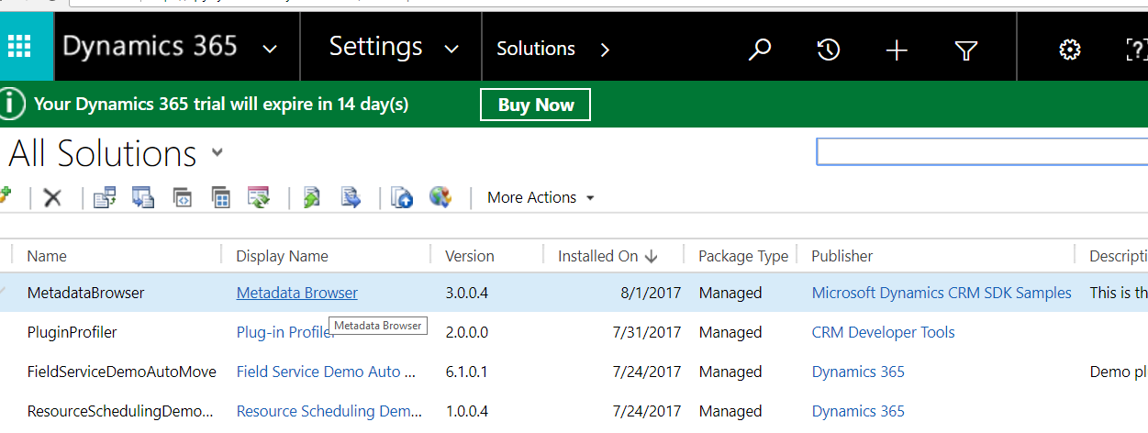
Metadata Browser

Slide 21
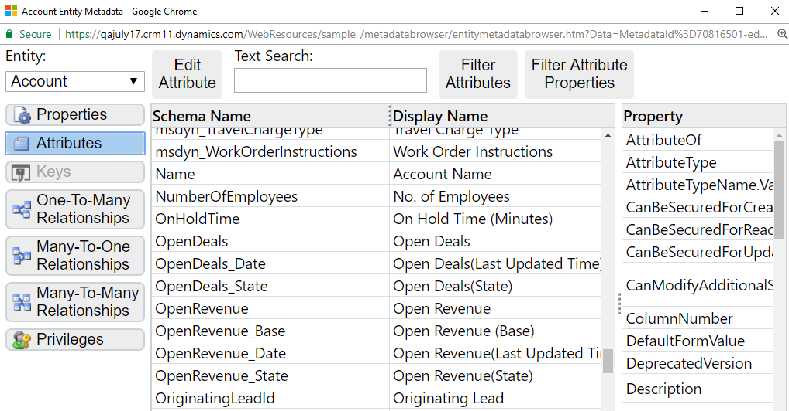
Metadata Browser

Slide 22
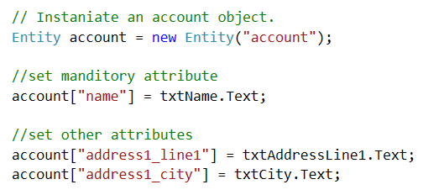
Late Bound Example
Notes:
Unlike early binding, developers need to be familiar with the schema names of entities and their attributes as intellisense is not available using Late Binding. The MetaData browser can be used to access this information accurately.

Slide 23
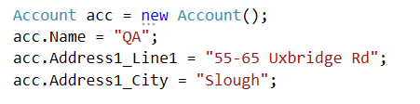
Early Bound Example
Note: Early bound reduces developer time as compilation error with spelling mistakes – but would need to update early bound entities to accommodate changes in the system
Schema name is usually uppercase for system types used

Slide 24
CrmSvcUtil.exe – generating early bound types
The CrmSvcUtil.exe is distributed with the SDK
Run from the command line or a batch script
Command line switches can be used to affect output
Support types that allow optionset values to be set
Generate A serviceContext class to enable Linq-based operations
CrmSvcUtil.exe /url:https://qajuly17.api.crm11.dynamics.com/XRMServices/2011/Organization.svc /out:Entities.cs /username:paul@qajuly17.onmicrosoft.com /password:QaJuly17 /namespace:DynamicsLinq /serviceContextName:OrgServiceContext
Notes:
/generateActions
This flag creates OrgamizationService Request Messages for each Action process in Dynamics 365, the parameters defined in the action become properties of the Request and corresponding Response message.
/serviceContextName
This flag creates a DataServiceContext, a kind of in memory datastore, from which LINQ operations can be made, and modifications saved.
Eg.
var result=context.AccountSet.Where(a=>a.Address1_City==“London”).First();
result.Address1_City=“Paris”;
context.SaveChanges()
Using the CrmSvcUtil to generate early bound enumerations for optionsets
CrmSvcUtil.exe /url:http://lon-dc1:5555/AdventureWorksCycles/XRMServices /2011/Organization.svc /username:CrmAdmin /password:Pa$$w0rd /namespace:Xrm /out:C:\crm\output\typesafeclasses_inc_enums.cs /serviceContextName:XrmServiceContext /codecustomization:"GenerateOptionSetEnums.CodeCustomizationService, GenerateOptionSetEnums" /codewriterfilter:"GenerateOptionSetEnums.FilteringService, GenerateOptionSetEnums" /basetypes:Microsoft.Xrm.Client.CrmEntity

Slide 25
Handling Dynamics Data
Attributes in Crm Database | Attribute Exposed in .Net
Boolean | bool
DateTime | System.DateTime
Integer | int
Lookup | EntityReference
Money | Microsoft.Xrm.Sdk.Money
Picklist | OptionSetValue
UniqueIdentifier / PrimaryKey | System.Guid
Notes:
Early bound types field exposed as .net type
Lead lead = new Lead();
lead.EstimatedValue = 1234;
lead.NumberOfEmployees = 999;
Guid g = service.Create(lead);
But Late bound fields as attributes of entity
Entity lead = new Entity("lead");
lead["subject"] = "late bound demo";
lead["numberofemployees"] = 699;
lead.SetAttributeValue("revenue", new Money((decimal)164.55));
//or
//lead.SetAttributeValue<Money>("revenue", 164.55);
Guid g = service.Create(lead);
Or use the generic function getAttributeValue<>()to return a typed value.
Lead.getAttributeValue<int>(“numberofemployees) // int
Notice: The integer type is common to .Net and Crm but the Money type is specific to Crm and therefore a Money object is created to be assigned to the field. In oData syntax numeric field values are referenced like FieldSchemaName/Value

Slide 26

Handling Dynamics 365 Data – OptionSetValue
Late bound
Early bound
Notes:
Refer to the section on the CrmSvcUtil to generate option sets as early bound enumerations. To read the values of OptionSets, a MetaDataRequest is needed, and executed through the OrganizationService – refer to the OrganizationRequest section of this module.
Contact.Attributes["gendercode"] = new OptionSetValue(1);

Slide 27
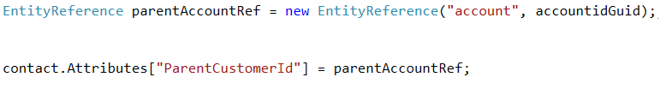
Handling Data - EntityReference
Late Bound

Slide 28
Handling Data - EntityReference
Early Bound
From an existing parent entity (early or late bound)

Slide 29
Organization Service
Methods
Create
Retrieve
RetrieveMultiple
Update
Delete
Execute
Create OrganizationService object from SDK (Microsoft.Xrm.Client).
Notes:
The OrganizationService from Microsoft.Xrm.Client encapsulates the IOrganizationService from the Microsoft.Xrm.Sdk assembly, used in earlier SDKs. The OrganizationService also implements IDisposable for better resource management.
All the CRUD methods (Create, Update, Delete, Retrieve) are wrappers to the underlying Execute method.
var connection = new CrmConnection("crmOnline");
using(var service = new OrganizationService(connection))
{
Lead lead = new Lead();
lead.Subject = "early bound using demo";
Guid g= service.Create(lead);
Lead lead2 = new Lead();
lead2.Subject = “another lead";
service.Create(lead2);
Entiy firstLead=service.Retrieve(“lead”,g,new ColumnSet(“subject”));
}//dispose of OrganizationService proxy resources

Slide 30
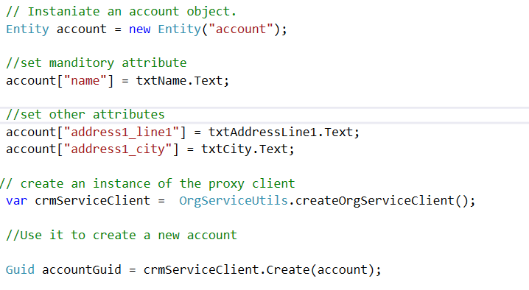
OrganizationService - Create
Late Bound
Notes:
The crmServiceClient variable above is of type CrmServiceClient. This type is provided by the tooling connector dll.

Slide 31
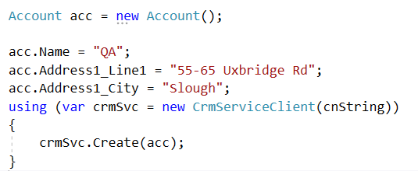
OrganizationService - Create
Early Bound

Slide 32
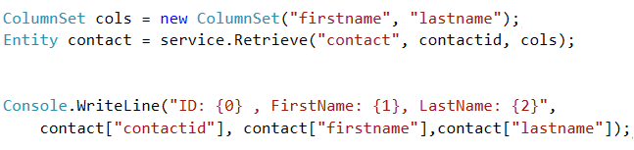
Organization Service – Retrieve
Late Bound
//note the contactid is returned in field collection implicitly
Notes:
The retrieve method takes the logicalname of the entity, the guid of the record to find and a list of fields to return in the result. If the database value is null for this field, it is not returned in the attributes collection of the returned entity. However the id of the record is always returned implicitly, and the use of entity.getAttribute<type>() avoids the error of trying to read a non existent item in the attributes collection.
If a field holds a null value in the database, but is requested in the ColumnSet, the entity returned does not contain an attribute in the attributes collection for that field. So even a check like this errors as calling the ToString method on a null object. This causes a KeyNotFoundException.
if(entity[“field_that_could_be_null”]!=null)
{
var value=entity[“field_that_could_be_null”].ToString();
}
One way to get round this is to check if the field is in the attributes collection
if(entity.Contains(“field_that_could_be_null”))
{
var value=entity[“field_that_could_be_null”].ToString();
}

Slide 33
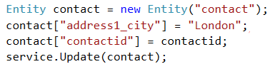

Organization Service – Update
Late Bound
Early Bound
Notes:
Note that the Update technique uses a new object with the fields required to be changed and the id to identify it. This is an alternative to retrieving the record first and then updating the modified record, as this would cause 2 database requests.
The Delete method requires only the entity logical name and record guid.
Update issues – avoid sending updates that set values without actually changing them – this can cause unexpected side effects.

Slide 34
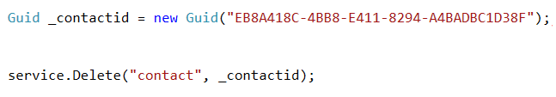
Organization Service – Delete

Slide 35
OrganizationService – RetrieveMultiple
The QueryExpression is like a TSQL statement
Select ==ColumnSet
From==entityname
Where==FilterExpression
Order By==OrderExpression
Notes:
https://msdn.microsoft.com/en-gb/library/microsoft.xrm.sdk.iorganizationservice.retrievemultiple.aspx
You can use this method to retrieve records of an entity that supports the RetrieveMultiple message, including records from custom entities.
The collection of returned records contains the values for the properties that are specified in the ColumnSet parameter for which the calling user has access rights. Any other property values are not returned.
Pass null for the columnSet parameter to retrieve only the primary key. If the columnSet includes attributes that are not valid for retrieval, they are ignored

Slide 36
OrganizationService – RetrieveMultiple
var cityCondition = new ConditionExpression();
cityCondition.AttributeName = "address1_city";
cityCondition.Operator = ConditionOperator.Like;
cityCondition.Values.Add(txtCitySearch.Text + "%")
FilterExpression cityFilter = new FilterExpression();
cityFilter.Conditions.Add(cityCondition);
Notes:
https://msdn.microsoft.com/en-us/library/gg334419.aspx
In Microsoft Dynamics 365 and Microsoft Dynamics 365 (online), you can use the FilterExpression class to build a query that expresses multiple conditions. For example, you can create a query expression that is the equivalent of a SQL statement such as ([LastName] = ‘Tharpe' OR [LastName] = 'Brown') AND [City] = 'Redmond’.
e.g.
QueryExpression query = new QueryExpression("contact"); query.ColumnSet.AddColumns("firstname", "lastname", "address1_city");
query.Criteria = new FilterExpression(); query.Criteria.AddCondition("address1_city", ConditionOperator.Equal, "Redmond");
FilterExpression childFilter = query.Criteria.AddFilter(LogicalOperator.Or);
childFilter.AddCondition("lastname", ConditionOperator.Equal, "Tharpe");
childFilter.AddCondition("lastname", ConditionOperator.Equal, "Brown");
// Pass query to service proxy
EntityCollection results = _serviceProxy.RetrieveMultiple(query);

Slide 37
OrganizationService - RetrieveMultiple
QueryExpression query = new QueryExpression("account");
query.ColumnSet.AddColumns("name", "address1_city","accountid");
query.Criteria.AddFilter(cityFilter);
query.Orders.Add(new OrderExpression("name", OrderType.Ascending));
crmServiceClient.RetrieveMultiple(query).Entities;
Notes:
QueryExpression.Orders Property
Gets the order in which the entity instances are returned from the query.

Slide 38
Module 2 Lab C
Creating and retrieving entity information using late bound types

Slide 39
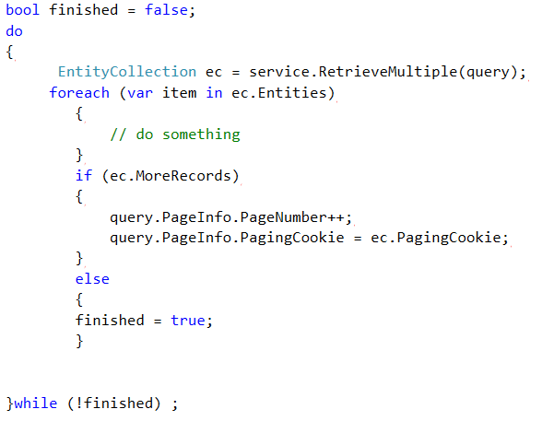
RetrieveMultiple - Paging
Notes:
PageInfo Property
Gets or sets the number of pages and the number of entity instances per page returned from the query
In Microsoft Dynamics 365 (online & on-premises), you can use the paging cookie feature to make paging in an application faster for large datasets. The feature is available in both FetchXML and QueryExpression queries. When you use the paging cookie feature when querying a set of records, the result contains a value for the paging cookie. To improve system performance, you can then pass that value when you retrieve the next set of records.

Slide 40
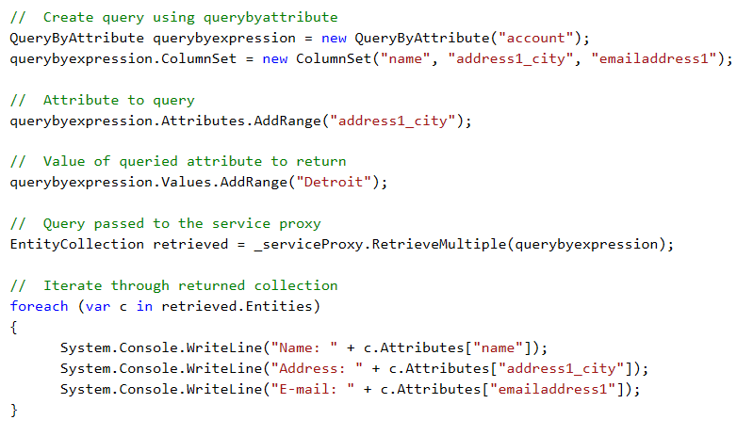
QueryByAttribute
Notes:
https://msdn.microsoft.com/en-gb/library/gg328259.aspx
The QueryByAttribute class is a simpler alternative to the QueryExpression class, that can be used to build queries testing for a set of attributes values.

Slide 41
OrganizationServiceFault
WCF services throw FaultException of type OrganizationServiceFault, from data type mismatches, Referential Integrity violations, records to be modified being already deleted, etc.
catch (FaultException<Microsoft.Xrm.Sdk.OrganizationServiceFault> ex)
{
Console.WriteLine("The application terminated with an error."); Console.WriteLine("Timestamp: {0}", ex.Detail.Timestamp); Console.WriteLine("Code: {0}", ex.Detail.ErrorCode); Console.WriteLine("Message: {0}", ex.Detail.Message); Console.WriteLine("Inner Fault: {0}", null == ex.Detail.InnerFault ? "No Inner Fault" : "Has Inner Fault");
}
Notes:
FaultException<OrganizationServiceFault> will be thrown with the execution of a bad request or invalid connection information. The Detail of the FaultException is the OrganizationServiceFault object it contains, it has extra information such as errorDetails, errorCode and TraceText
Other common exceptions are security related, trying to access entities or perform actions without privilege; eg.
SecurityTokenValidationException
ExpiredSecurityTokenException
SecurityAccessDeniedException
MessageSecurityException
SecurityNegotiationException
Note: You can throw a OrganizationServiceFault by querying an entity or field that does not exist, whilst an inaccurate connection string will result in a clientside exception.
"\helper_scripts\mod2_RetrieveFaultException.txt"
Other exceptions and faults to handle are likely from trying to access records or commands not accessible to the current user:

Slide 42
LINQ
Linq (Language Integrated Query)
A common cross data query technique that can be applied to arrays, collections of objects, XML, Relational Data
Can query with a TSQL style or Lambda expressions, via Entity Collections of OrganizationServiceContext
Linq for Dynamics is a subset of Linq for collection types (no count or other aggregate methods)
Use the CrmSvcUtil class to generate early bound entities and an OrganizationalServiceContext class
OrganizationalServiceContext class exposes Iqueryable entity sets
Entity set names follow pattern <entity schema name> + Set e.g. AccountSet, ContactSet
Notes:
You can use .NET Language-Integrated Query (LINQ) to write queries in Microsoft Dynamics 365 (online & on-premises). You can use the OrganizationServiceContext class or a deriving class created by the CrmSvcUtil tool to write LINQ queries that access the SOAP endpoint (Organization.svc). The OrganizationServiceContext class contains an underlying LINQ query provider that translates LINQ queries from Microsoft Visual C# or Microsoft Visual Basic .NET syntax into the query API used by Microsoft Dynamics 365.
When you use early-bound programming classes you can generate a class derived from the OrganizationServiceContext class if you specify the name of the class using the servicecontextname parameter when using the Code Generation Tool (CrmSvcUtil.exe). Use of this class allows for referencing an IQueryable entity set using the pattern <entity schema name>+Set, for example AccountSet to reference the collection of Account entity records. All samples in the Microsoft Dynamics 365 SDK use ServiceContext as the name for this class but your code may use a different name

Slide 43
LINQ
using (var crmSvc = new CrmServiceClient(cnString))
{
OrgServiceContext ctx = new OrgServiceContext(crmSvc);
var accounts = ctx.AccountSet.OrderBy(acc => acc.Name).Take(10);
return View(accounts);
}
Notes:
Developers familiar with Linq syntax will be able to construct requests for Dynamics 365 data.

Slide 44
LINQ Operators
Select
Join
from c in context.ContactSet select c; //all fields
from c in context.ContactSet select c.FullName; //just fullname
from c in context.ContactSet join a in
context.AccountSet on c.ContactId
equals a.PrimaryContactId.Id

Slide 45
LINQ Operators
Orderby
from c in context.ContactSet orderby c.LastName ascending select c;
where
from c in context.ContactSet where c.Address1_City == "Redmond"
orderby c.LastName ascending select c;

Slide 46
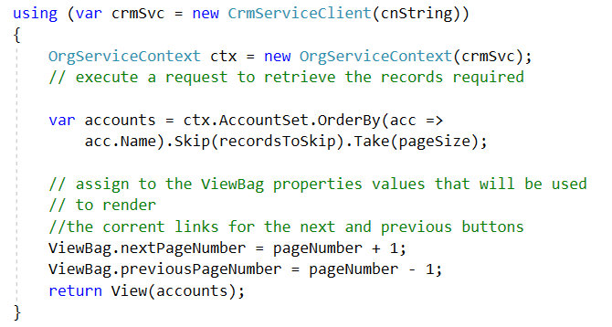
LINQ Extension methods
Notes:
The Take and Skip extension methods can be used to implement paging operations

Slide 47
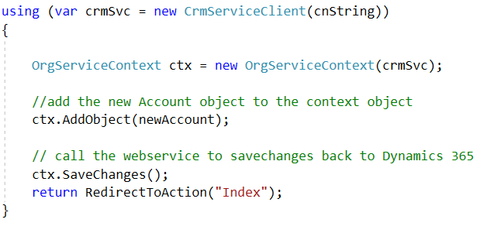
Creating, Updating, and Deleting Records with LINQ
Create
Notes:
Updating can be performed in two stages a Retrieve and an Update.
using (CRMServiceContext ctx = new CRMServiceContext(service))
{
//Retrieve
Contact contact = ctx.ContactSet.Single(c => c.LastName == “Clarkson");
//Update
contact.JobTitle = “ex BBC presenter";
ctx.UpdateObject(contact);
ctx.SaveChanges();
}
Alternatively if the id of the entity is known, then the entity can be created locally with the modified field value and then updated through the OrganizationService.Update() method
using (CRMServiceContext ctx = new CRMServiceContext(service))
{
Contact contact = new Contact() { ContactId = new Guid("A6A6F447-75BB-E411-80E0-C4346BAD8144"), JobTitle = “Bus Driver" };
service.Update(contact);
}

Slide 48
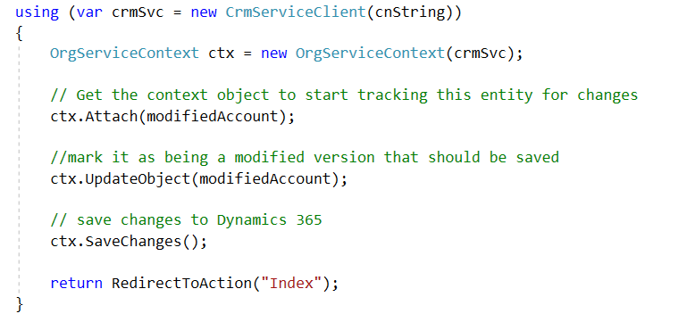
Creating, Updating, and Deleting Records with LINQ
Update
Notes:
Updating can be performed in two stages a Retrieve and an Update.
using (CRMServiceContext ctx = new CRMServiceContext(service))
{
//Retrieve
Contact contact = ctx.ContactSet.Single(c => c.LastName == “Clarkson");
//Update
contact.JobTitle = “ex BBC presenter";
ctx.UpdateObject(contact);
ctx.SaveChanges();
}
Alternatively if the Entity has not be retrieved previously then the entity needs to be attached to the the DataServiceContext object which enables change tracking. The modified entity is then marked as being updated by calling the UpdateObject method of the Context object before calling the SaveChanges method.

Slide 49
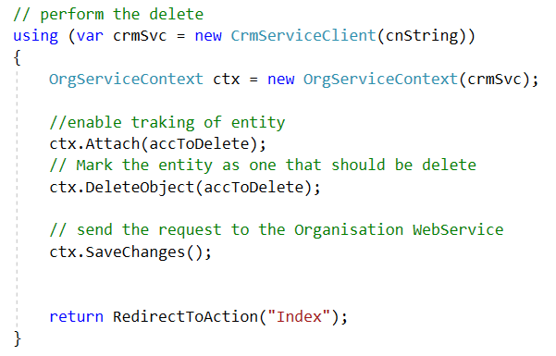
Creating, Updating, and Deleting Records with LINQ
Delete
Notes:
Deleting an entity is similar to the updating of an entity. If the entity has been retrieved previously an is already attached to the context object then we just need to call DeleteObject before SaveChanges. If the Entity is not attached, then Attach it first before calling DeleteObject and SaveChanges.

Slide 50
Module 2 Lab D
Using LINQ

Slide 51
Using FetchXML
What is FetchXML?
Native query syntax for Crm
Common uses
Reporting
Aggregation
QueryExpression
Saved Views
Notes:
FetchXml is the native querying syntax used within the CRM system. It is used for reporting as it provides cross join views of the data as well as various aggregate functions. FetchXml expressions can be written manually, or with the Advanced Find query designer – then Save FetchXml option. There are even some tools to create FetchXml outside of CRM.
One advantage of using FetchXml over some of the other data techniques is that it can be saved in an external file and modified outside of compilation of the consumer application. It can also be used as the source of views

Slide 52
Using FetchXML
This query selects all the contacts whose city is London
<fetch mapping='logical' distinct='false'>
<entity name='contact'>
<attribute name='fullname' />
<order attribute='fullname' descending='false' />
<filter type='and'>
<condition attribute=‘address1_city' operator='eq' value=‘London' />
</filter>
</entity>
</fetch>
Use the ..sdk\schemas\fetch.xsd for support in Visual Studio
Notes:
Comparing to TSQL
select fields==<attribute name=‘fullname’/>
from table==<entity name=‘contact’>
where predicate== <condition attribute=‘address1_city' operator='eq' value=‘London‘ />
orderby field== <order attribute='fullname' descending='false‘ />
Using a FetchExpression
var xml=@” <fetch version='1.0' output-format='xml-platform' mapping='logical' distinct='false'> <entity name='contact'>
<attribute name='fullname' />
</entity></fetch>”;
var entities=service.RetrieveMultiple(new FetchExpression(xml)).Entites;
foreach (Entity item in entities)
{
Console.WriteLine("{0}\t[{1}]", item.Attributes["fullname"], item.Attributes["contactid"]);
}
NOTE: Like QueryExpression, the id field is returned without requesting it in the ColumnSet/Attributes section
"\helper_scripts\mod2_FetchXMLRetrieveMultiple.txt"

Slide 53
FetchXML - Aggregates
This example shows the use of aggregate and alias
string numberOfAccountsFetchXml = @"
<fetch distinct='false' mapping='logical' aggregate='true'>
<entity name='account'>
<attribute name='name' alias='account_count' aggregate='count'/>
</entity>
</fetch>";
Notes:
var connection = new CrmConnection("crmOnline");
var service = new OrganizationService(connection);
var city = "Seattle";
EntityCollection ec = service.RetrieveMultiple(new FetchExpression(@"
<fetch version='1.0' aggregate='true' output-format='xml-platform' mapping='logical' distinct='true'>
<entity name='contact'>
<attribute name='address1_city' alias='citycount' aggregate='count' />
<filter type='and'>
<condition attribute='address1_city' operator='eq' value='" + city + @"' />
</filter>
</entity>
</fetch>"));
Console.WriteLine("Number of contacts in {0}: {1}", city, (Int32)(ec[0].GetAttributeValue<AliasedValue>("citycount").Value));
Note the only way to execute this aggregate is through the RetrieveMultiple method, even though a single result is returned. The aggregate result needs to be cast from an AliasedValue to its logical type.
"\helper_scripts\mod2_FetchXMLCount.txt"

Slide 54
FetchXML Executing the request
This example shows the use of aggregate and alias
EntityCollection numberOfAccounts = crmSvc.RetrieveMultiple(new FetchExpression(numberOfAccountsFetchXml));
int number = (int)((AliasedValue)numberOfAccounts[0]["account_count"]).Value;
return number.ToString();

Slide 55
Limitations of FetchXML
No support for unions, but do have Outer Joins
Only one aggregate attribute can be specified in a query
Default 50,000 record limit for CRM Online and On-Premise
Can adjust setting On-Premise, not Online
Notes:
You can get Fetch XML from Advanced Find or LINQPad - http://blogs.msdn.com/b/devkeydet/archive/2012/04/22/getting-fetchxml-from-linqpad.aspx
You can use FetchXmlToQueryExpressionRequest to convert to Query Expression and QueryExpressionToFetchXmlRequest to go the other way
Aggregate values are returned rom a RetrieveMultipleRequest as an AliasValues data type and need to be cast to the int or decimal, depending on what field being aggregated.
The issue of the null values being used as zero in aggregates can be avoided by querying with a predicate to eliminate null values, as well as the aggregate statemement.
The XrmToolbox provides a tool to run FetchXml outside of code.

Slide 56
Notes:
The following code demonstrates the use of an outer join to find contacts with no associated parent customer
<fetch version='1.0' output-format='xml-platform' mapping='logical' distinct='true'>
<entity name='contact'>
<attribute name='fullname' />
<attribute name='contactid' />
<order attribute='fullname' descending='false' />
<link-entity name='account' from='accountid' to='parentcustomerid' alias='ae' link-type='outer'>
<attribute name='accountid' />
</link-entity>
<filter type='and'>
<condition entityname='ae' attribute='accountid' operator='null' />
</filter>
</entity>
</fetch>

Slide 57
WebAPI
What is WebAPI?
REST-based data service
Replacement for Odata and OrganizationService
Call from Client-side web resource
CRUD operations within Dynamics 365 security context
Access to framework functions
Example:
https://qa501.api.crm4.dynamics.com/api/data/v8.1/contacts?$select= firstname, lastname &$filter= address1_city eq 'London'
st queries through the browser (URLs)

Slide 58
WebAPI methods
Operation | Description
$expand | Directs that related records should be retrieved in the record or collection being retrieved
$filter | Specifies an expression or function that must evaluate to true for a record to be returned in the collection
$orderby | Determines what values are used to order a collection of records
$select | Specifies a subset of properties to return
$skip | Sets the number of records to skip before it retrieves records in a collection
$top | Determines the maximum number of records to return
$count | Count of entity set
Notes:
$orderby
http://lon-dc1:5555/AdventureWorksCycles/api/data/v8.2/contacts?$select=firstname , lastname&$orderby= lastname desc
$select
http://lon-dc1:5555/AdventureWorksCycles/api/data/v8.2/contacts?$select=firstname , lastname,address1_city
$filter
http://lon-dc1:5555/AdventureWorksCycles/api/data/v8.2/contacts?$select=fullname&$filter=address1_city eq ‘London’
$skip
http://lon-dc1:5555/AdventureWorksCycles/api/data/v8.2/contacts?$select=firstname , lastname&$skip=10
$top
http://lon-dc1:5555/AdventureWorksCycles/api/data/v8.2/contacts?$select=firstname , lastname&$orderby= lastname desc
&$skip=10&$top=2
http://lon-dc1:5555/AdventureWorksCycles/api/data/v8.2/contacts?$count=true
NOTE: Using lower case logical names

Slide 59
WebAPI/Odata operators
Operator | Description | Example
eq | Equal | /accounts?$filter=address1_city eq 'Redmond'
ne | Not equal | /accounts?$filter=address1_city ne null
gt | Greater than | /accounts?$filter=creditlimit gt 1000
ge | Greater than or equal | /accounts?&$filter=creditlimit ge 1000
lt | Less than | /accounts?$filter=creditlimit lt 1000
le | Less than or equal | /accounts?$filter=creditlimit le 1000
and | Logical and | /accounts?$filter=creditlimit ge 1000 and address1_stateorprovince eq 'TX'
or | Logical or | /accounts?$filter=accountcategorycode eq 2 or accountratingcode eq 1
not | Logical Negation | /accounts?$filter=(accountcategorycode ne null) and not (accountcategorycode eq 1)

Slide 60
Module 2 Lab E
Using FetchXML

Slide 61
Summary
No data access technique meets all scenarios
Aggregate methods limited to FetchXml and FilteredViews (Although any collection can be aggregated)
CRUD only available through WebApi, LINQ, and OrganizationService.Execute, Create, Update, Delete methods
FetchXml is the generic query technique used internally by system
Web service calls can be made from a wide audience and allows access to system functions not just data access
Chose technique for options of full CRUD, aggregation, intellisense, early binding, simplicity, scope
Notes:
SDK samples
SDK\SampleCode\CS\GeneralProgramming\Queries
Although only FetchXml and Filtered Views are the only techniques to directly support aggregates, the resultsets from the other techniques can be treated as collections from which standard LINQ expressions can be applied:
Using late bound collections
var count=service.RetrieveMultiple(qryExpression).Entites.Count();
Using early bound collections
var connection = new CrmConnection("crmOnline");
using (var service = new OrganizationService(connection))
{
using (CRMServiceContext ctx = new CRMServiceContext(service))
{
var ops = ctx.OpportunitySet.Where(o => o.ActualCloseDate.Value < DateTime.Now.AddMonths(1)).ToList();
var max = ops.Max(o => o.EstimatedValue.Value);
var min = ops.Min(o => o.EstimatedValue.Value);
Console.WriteLine("ops count:{0}\nops max:{1}\nops min:{2}", ops.Count, max, min);
}
}

